Slide 1


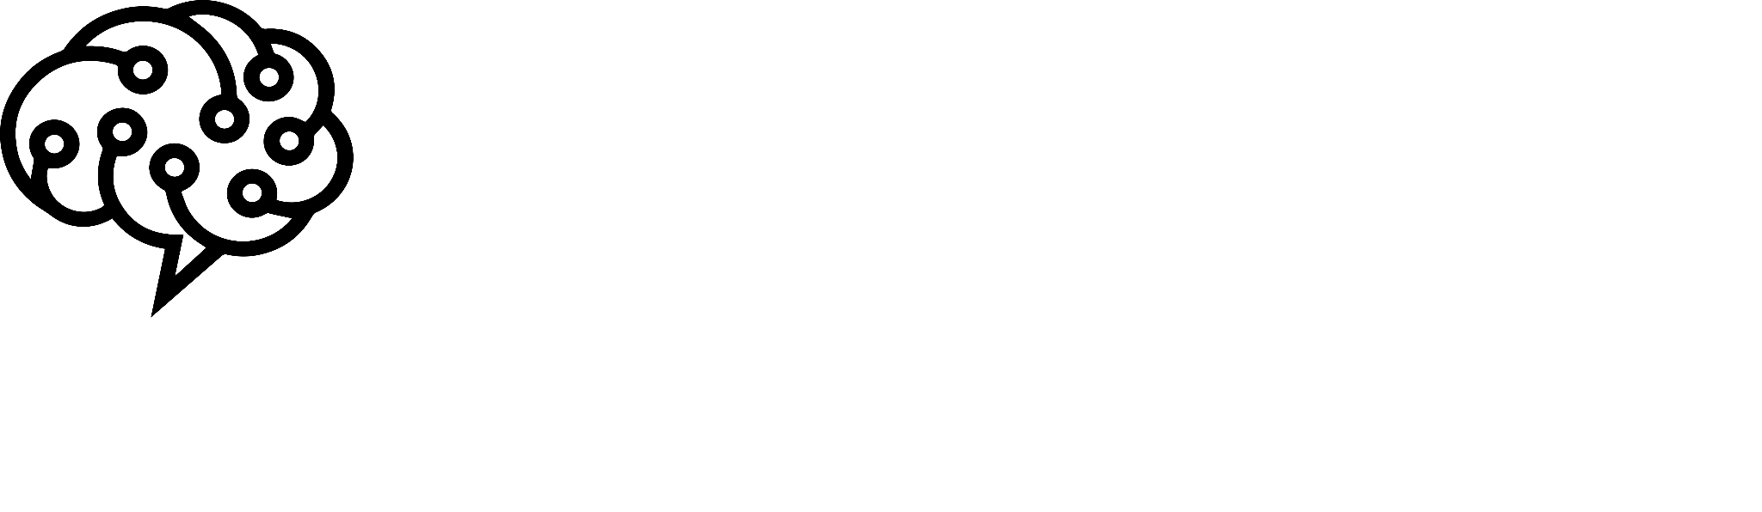
ML in Natural Language Processing
ABBOUD Massi-Nissa
km_abboud@esi.dz

Slide 2


What are we going to cover
Language Modeling with N-Grams
Text classification with Naive bayes & Logistic regression
Vectors and semantics for Information retrieval
CRF for Named Entity Recognition

Slide 3

Language Modeling is the task of predicting the next word (or sequence of words) in a sentence or text given the context of the preceding words.
Question: How do we, as humans, predict the next word of a sequence?

Slide 4

N-grams: are contiguous sequences of n tokens in a given text or speech. They are often used to model the likelihood of a word given its surrounding context.
The intuition of the n-gram model is that instead of computing the probability of a word given its entire history, we can approximate the history by just the last few words.

Slide 5
Types of N-grams
Unigrams (1-grams): Single words considered in isolation. For example, in the sentence "The cat is fast," the unigrams are "The," "cat," "is," and "fast."
Bigrams (2-grams): Pairs of consecutive words. For instance, in the same sentence, the bigrams include "The cat," "cat is," and "is fast."
Trigrams (3-grams): Three consecutive words. In the example, trigrams include "The cat is" and "cat is fast."
4-grams, 5-grams, etc.: Sequences of four, five, or more consecutive words.

Slide 6

An intuitive way to estimate probabilities is called maximum likelihood estimation or MLE. We get the MLE estimate for the parameters of an n-gram model by getting counts from a corpus, and normalizing the counts so that they lie between 0 and 1.
As example, here is the formula to compute the bigram using MLE:

Slide 7
Example: Let’s compute the bigram of some of these words:
<s> I am Sam </s>
<s> Sam I am </s>
<s> I do not like green eggs and chicken </s>
P(I|<s>) = 2/3 = .67
P(</s>|Sam) = 1/2 = 0.5
P(Sam|<s>) = 1/3 = .33
P(Sam|am) = 1/2 = .5
P(am|I) = 2/3 = .67
P(do|I) = 1/3 = .33

Slide 8
Drawbacks of N-grams
Efforts to Overcome N-grams Limitations:
Limited Context Understanding
Data Sparsity
Inflexibility to Variations
Zero Probability for Unseen N-grams
Laplacian smoothing
Add-k smoothing
Backoff & interpolation
Kneser-Ney Smoothing

Slide 9
Coding

Slide 10
Text Classification
With
Naive Bayes & Logistic Regression

Slide 11

Text classification is the process of categorizing or labeling text into predefined categories or classes.
Text classification model
label
Examples:
Sentiment Analysis
Spam detection
Text categorization

Slide 12
Let’s assume that for each task, we have features f1,f2,..,fn that will help us classify the text.
Examples of some features:
Word counts in a document
Presence/absence of a word in a document
Term frequency
Term Frequency-Inverse Document Frequency (TF-IDF)

Slide 13
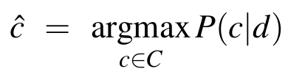
Naive Bayes is a probabilistic classifier, meaning that for a document d, out of
all classes c ∈ C the classifier returns the class ĉ which has the maximum posterior
probability given the document.

Slide 14
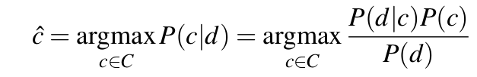

The intuition of Bayesian classification is to use Bayes’ rule to transform the previous equation into other probabilities that have some useful properties.
But P(d) doesn’t change for each class; we are always asking about the most likely class for the same document d, which must have the same probability P(d). which results in the following simplification:

Slide 15
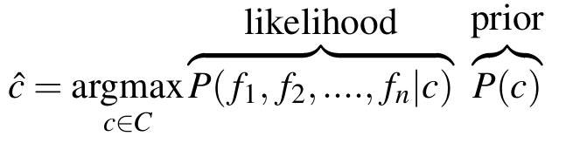

It is more intuitive to try to predict the probability of having some of the features in a class ĉ, thus we write:
Assuming that the features are independent, we can write:

Slide 16
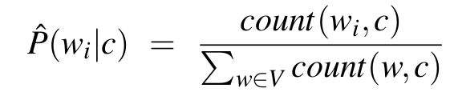
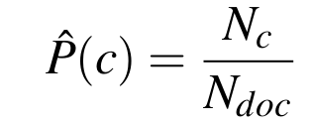
A very simple feature that we may use is counting the number of times a word appears in the documents of the class.
The probability P(c) can also be determined by counting the proportion of documents of class c in the set of documents of the training set.

Slide 17
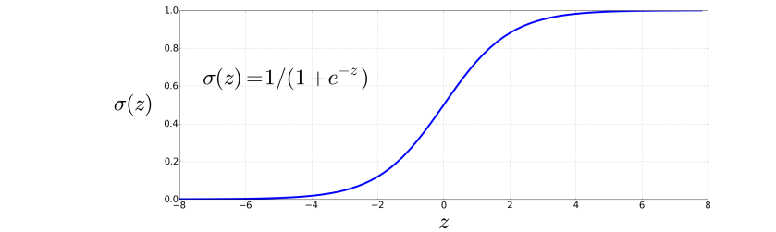



Logistic Regression is a statistical method commonly used for binary classification problems, and it can be adapted for multi-class classification as well. In the context of text classification, logistic regression is employed to predict the probability that a given document belongs to a particular category or class.
It works by learning the weights w associated to each feature that will output when passed to the sigmoid function the corresponding class.

Slide 18
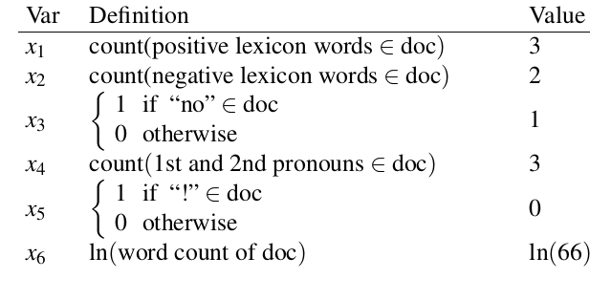
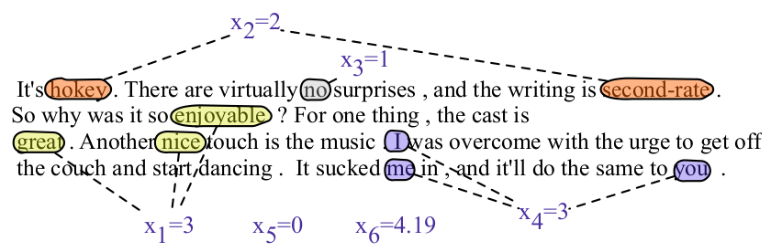

Slide 19
Coding

Slide 20
Vectors & Semantics for Information Retrieval

Slide 21
Exercise: from the following sentences, try to guess the meaning of the world Ongchoi
Ongchoi is delicious sauteed with garlic.
Ongchoi is superb over rice.
...ongchoi leaves with salty sauces...
...spinach sauteed with garlic over rice...
...chard stems and leaves are delicious...
...collard greens and other salty leafy greens

Slide 22
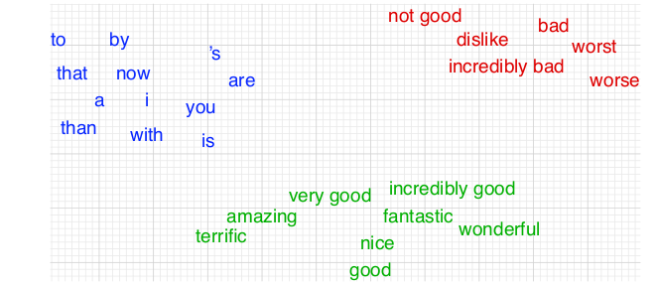
The idea of vector semantics is to represent a word as a point in a multidimensional semantic space that is derived from the distributions of word neighbors. Vectors for representing words are called embeddings.
A two-dimensional (t-SNE) projection of embeddings for some words and phrases, showing that words with similar meanings are nearby in space.

Slide 23
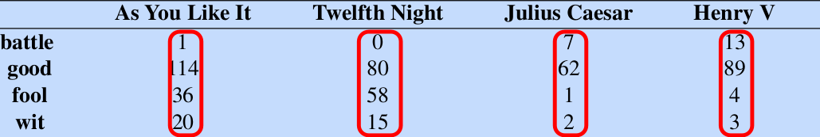
In a term-document matrix, each row represents a word in the vocabulary and each column represents a document from some collection of documents.
The term-document matrix for four words in four Shakespeare plays. The red boxes show that each document is represented as a column vector of length four.

Slide 24
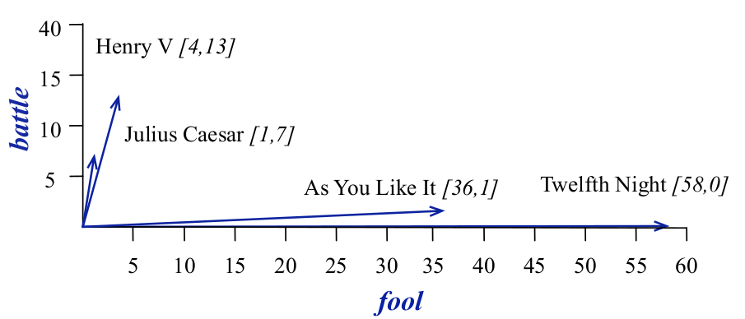
A spatial visualization of the document vectors for the four Shakespeare play documents, showing just two of the dimensions, corresponding to the words battle and fool. The comedies have high values for the fool dimension and low values for the battle dimension.

Slide 25
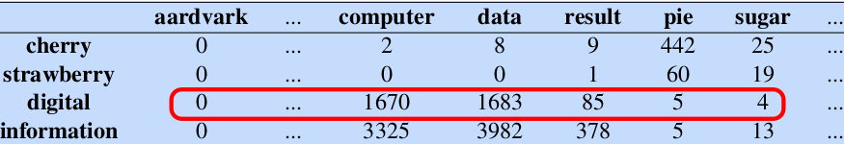
An alternative to using the term-document matrix to represent words as vectors of document counts, is to use the term-term matrix, also called the word-word matrix or the term-context matrix, in which the columns are labeled by words rather than documents.
Example:
…is traditionally followed by cherry pie, a traditional dessert…
…often mixed, such as strawberry rhubarb pie. Apple pie…
…computer peripherals and personal digital assistants. These devices usually…
…a computer. This includes information available on the internet…

Slide 26
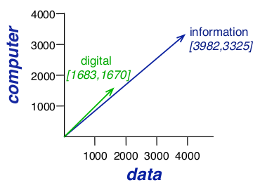
A spatial visualization of word vectors for digital and information, showing just two of the dimensions, corresponding to the words data and computer.

Slide 27
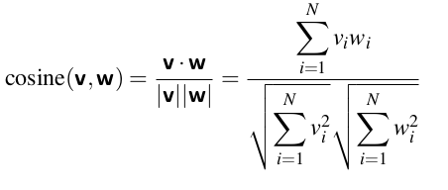
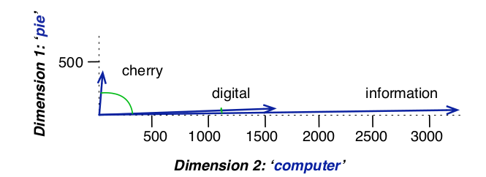
To measure similarity between two target words v and w, we need a metric that takes two vectors and gives a measure of their similarity. By far the most common similarity metric is the cosine of the angle between the vectors.

Slide 28

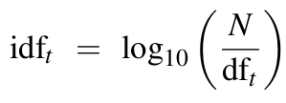
TF-IDF, which stands for Term Frequency-Inverse Document Frequency, is a numerical statistic used in information retrieval and text mining to evaluate the importance of a word in a document relative to its frequency across a collection of documents. It is commonly employed as a feature representation for text data in various NLP tasks, including text classification.
The tf-idf weighting is the product of two terms, each term capturing one of these two intuitions:
The first is the term frequency: the frequency of the word t in the document d. We can just use the raw count as the term frequency.
The inverse Document Frequency measures the importance of a term across a collection of documents. It is calculated as the logarithm of the ratio of the total number of documents to the number of documents containing the term, with the addition of 1 to prevent division by zero.

Slide 29
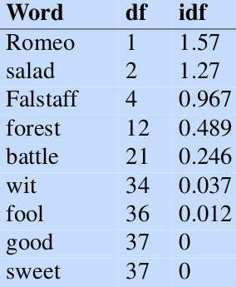

Here are some idf values for some words in the Shakespeare corpus, ranging from extremely informative words which occur in only one play like Romeo, to those that occur in a few like salad or Falstaff, to those which are very common like fool or so common as to be completely non-discriminative since they occur in all 37 plays like good or sweet.

Slide 30
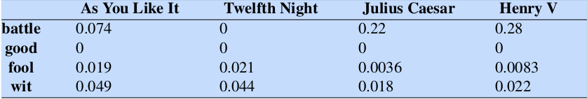
A tf-idf weighted term-document matrix for four words in four Shakespeare plays, using the counts in the previous figure.

Slide 31
Coding

Slide 32
Named Entity Recognition

Slide 33
A named entity is anything that can be referred to with a proper name: a person, a location, an organization. The task of named entity recognition (NER) is to find spans of text that constitute proper names and tag the type of the entity. Four entity tags are most common: PER (person), LOC (location), ORG(organization), or GPE (geo-political entity).
It can be extended to include things that aren’t entities, including dates, times, and other kinds of temporal expressions, and even numerical expressions like prices.
Citing high fuel prices, [ORG United Airlines] said [TIME Friday] it has increased fares by [MONEY $6] per round trip on flights to some cities also served by lower-cost carriers. [ORG American Airlines], a unit of [ORG AMR Corp.], immediately matched the move, spokesman [PER Tim Wagner] said. [ORG United], a unit of [ORG UAL Corp.], said the increase took effect [TIME Thursday] and applies to most routes where it competes against discount carriers, such as [LOC Chicago] to [LOC Dallas] and [LOC Denver] to [LOC San Francisco].

Slide 34
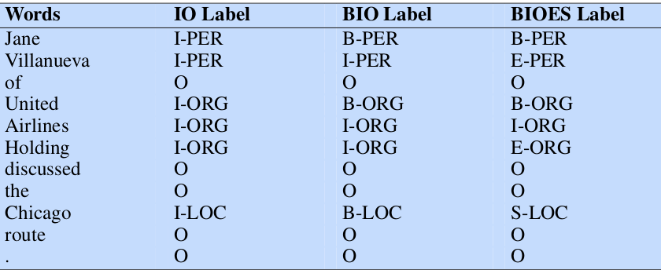
Tagging techniques:
The standard approach to sequence labeling for a span-recognition problem like NER is BIO tagging. Other variants like IO and BIOES are very used as well.
[PER Jane Villanueva ] of [ORG United] , a unit of [ORG United Airlines Holding] , said the fare applies to the [LOC Chicago ] route.

Slide 35
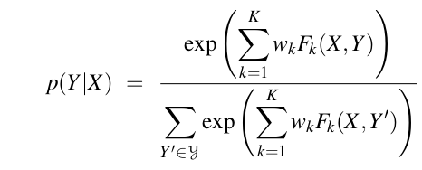
Conditional Random Fields (CRFs):
using X and Y as the input and output sequences. A CRF is a log-linear model that assigns a probability to an entire output (tag) sequence Y given the entire input (word) sequence X. We can think of a CRF as like a giant version of what multinomial logistic regression does for a single token.
In a CRF, the function F maps an entire input sequence X and an entire output sequence Y to a feature vector. Let’s assume we have K features, with a weight wk for each feature Fk.

Slide 36
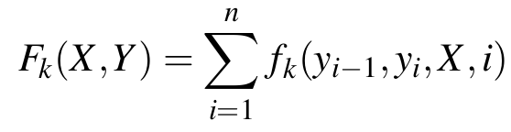
We’ll call these K functions Fk (X,Y ) global features, since each one is a property of the entire input sequence X and output sequence Y . We compute them by decomposing into a sum of local features for each position i in Y.
Some examples of features:
The first letter of the word is a capital letter.
The word contains a hyphen.
The previous word begins with a capital letter, and the current token is a dot.
The word belongs to a set of predefined words (eg. a gazetter).
The word ends with a suffix (ly, gy, ing…)
The word begins with one of the predefined prefixes.

Slide 37
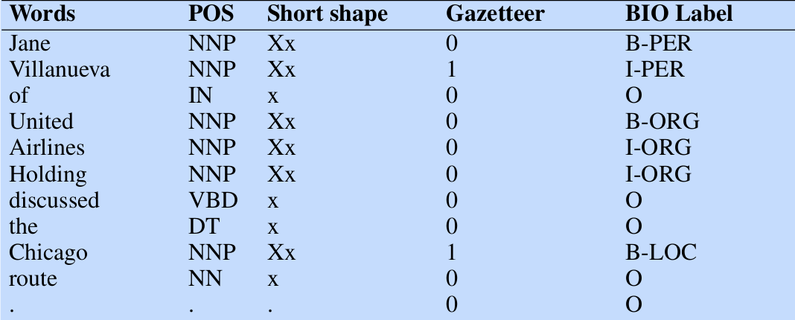

Slide 38
Coding

Slide 39
Thank you for attending
any questions ?

